Slide 1
Test Specification
Ali Tarraf
Ali Al-mugoter
Steve Karim

Slide 2
Introduction
The project is to develop a web application for the gamification of big data. The data that will be analyzed is data received from an inventory software, which keeps inventory of equipment that is used by teams. These teams should utilize the inventory software whenever they have jobs. Check if inventory is being returned. The data will be analyzed, and a scoring system will rank the teams, based on how much they utilized the software and if their equipment was returned. This will increase productivity.

Slide 3
Testing Strategy
Unit Testing
Web Application
Database
Integration Testing
Web Application
Database
Validation Testing - Test software as whole
Web Application
Database
High-order Testing
Web Application
Database

Slide 4
Unit Testing
Vertical slicing
3 main parts
Front-end:
Test related components
Test service
Test UI
Backend
Test API request/ Controller
Test related Query/Command classes
Database
Test related tables
Check for fields added/updated

Slide 5
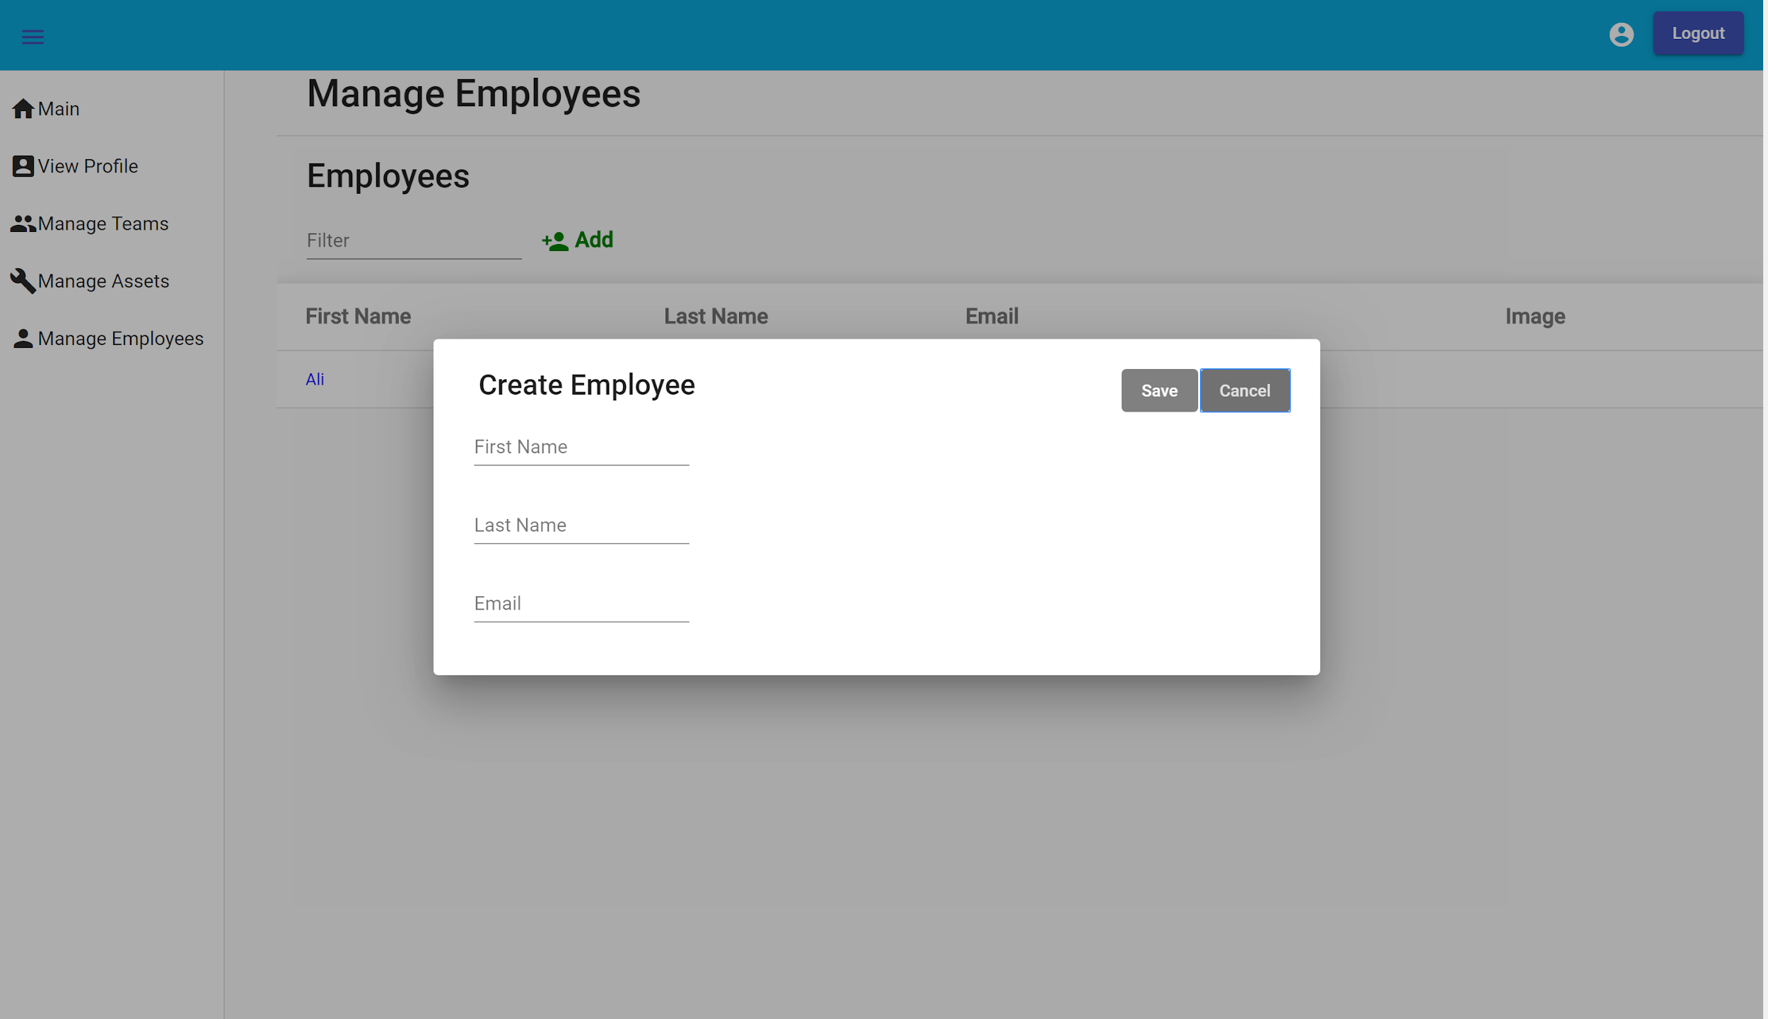
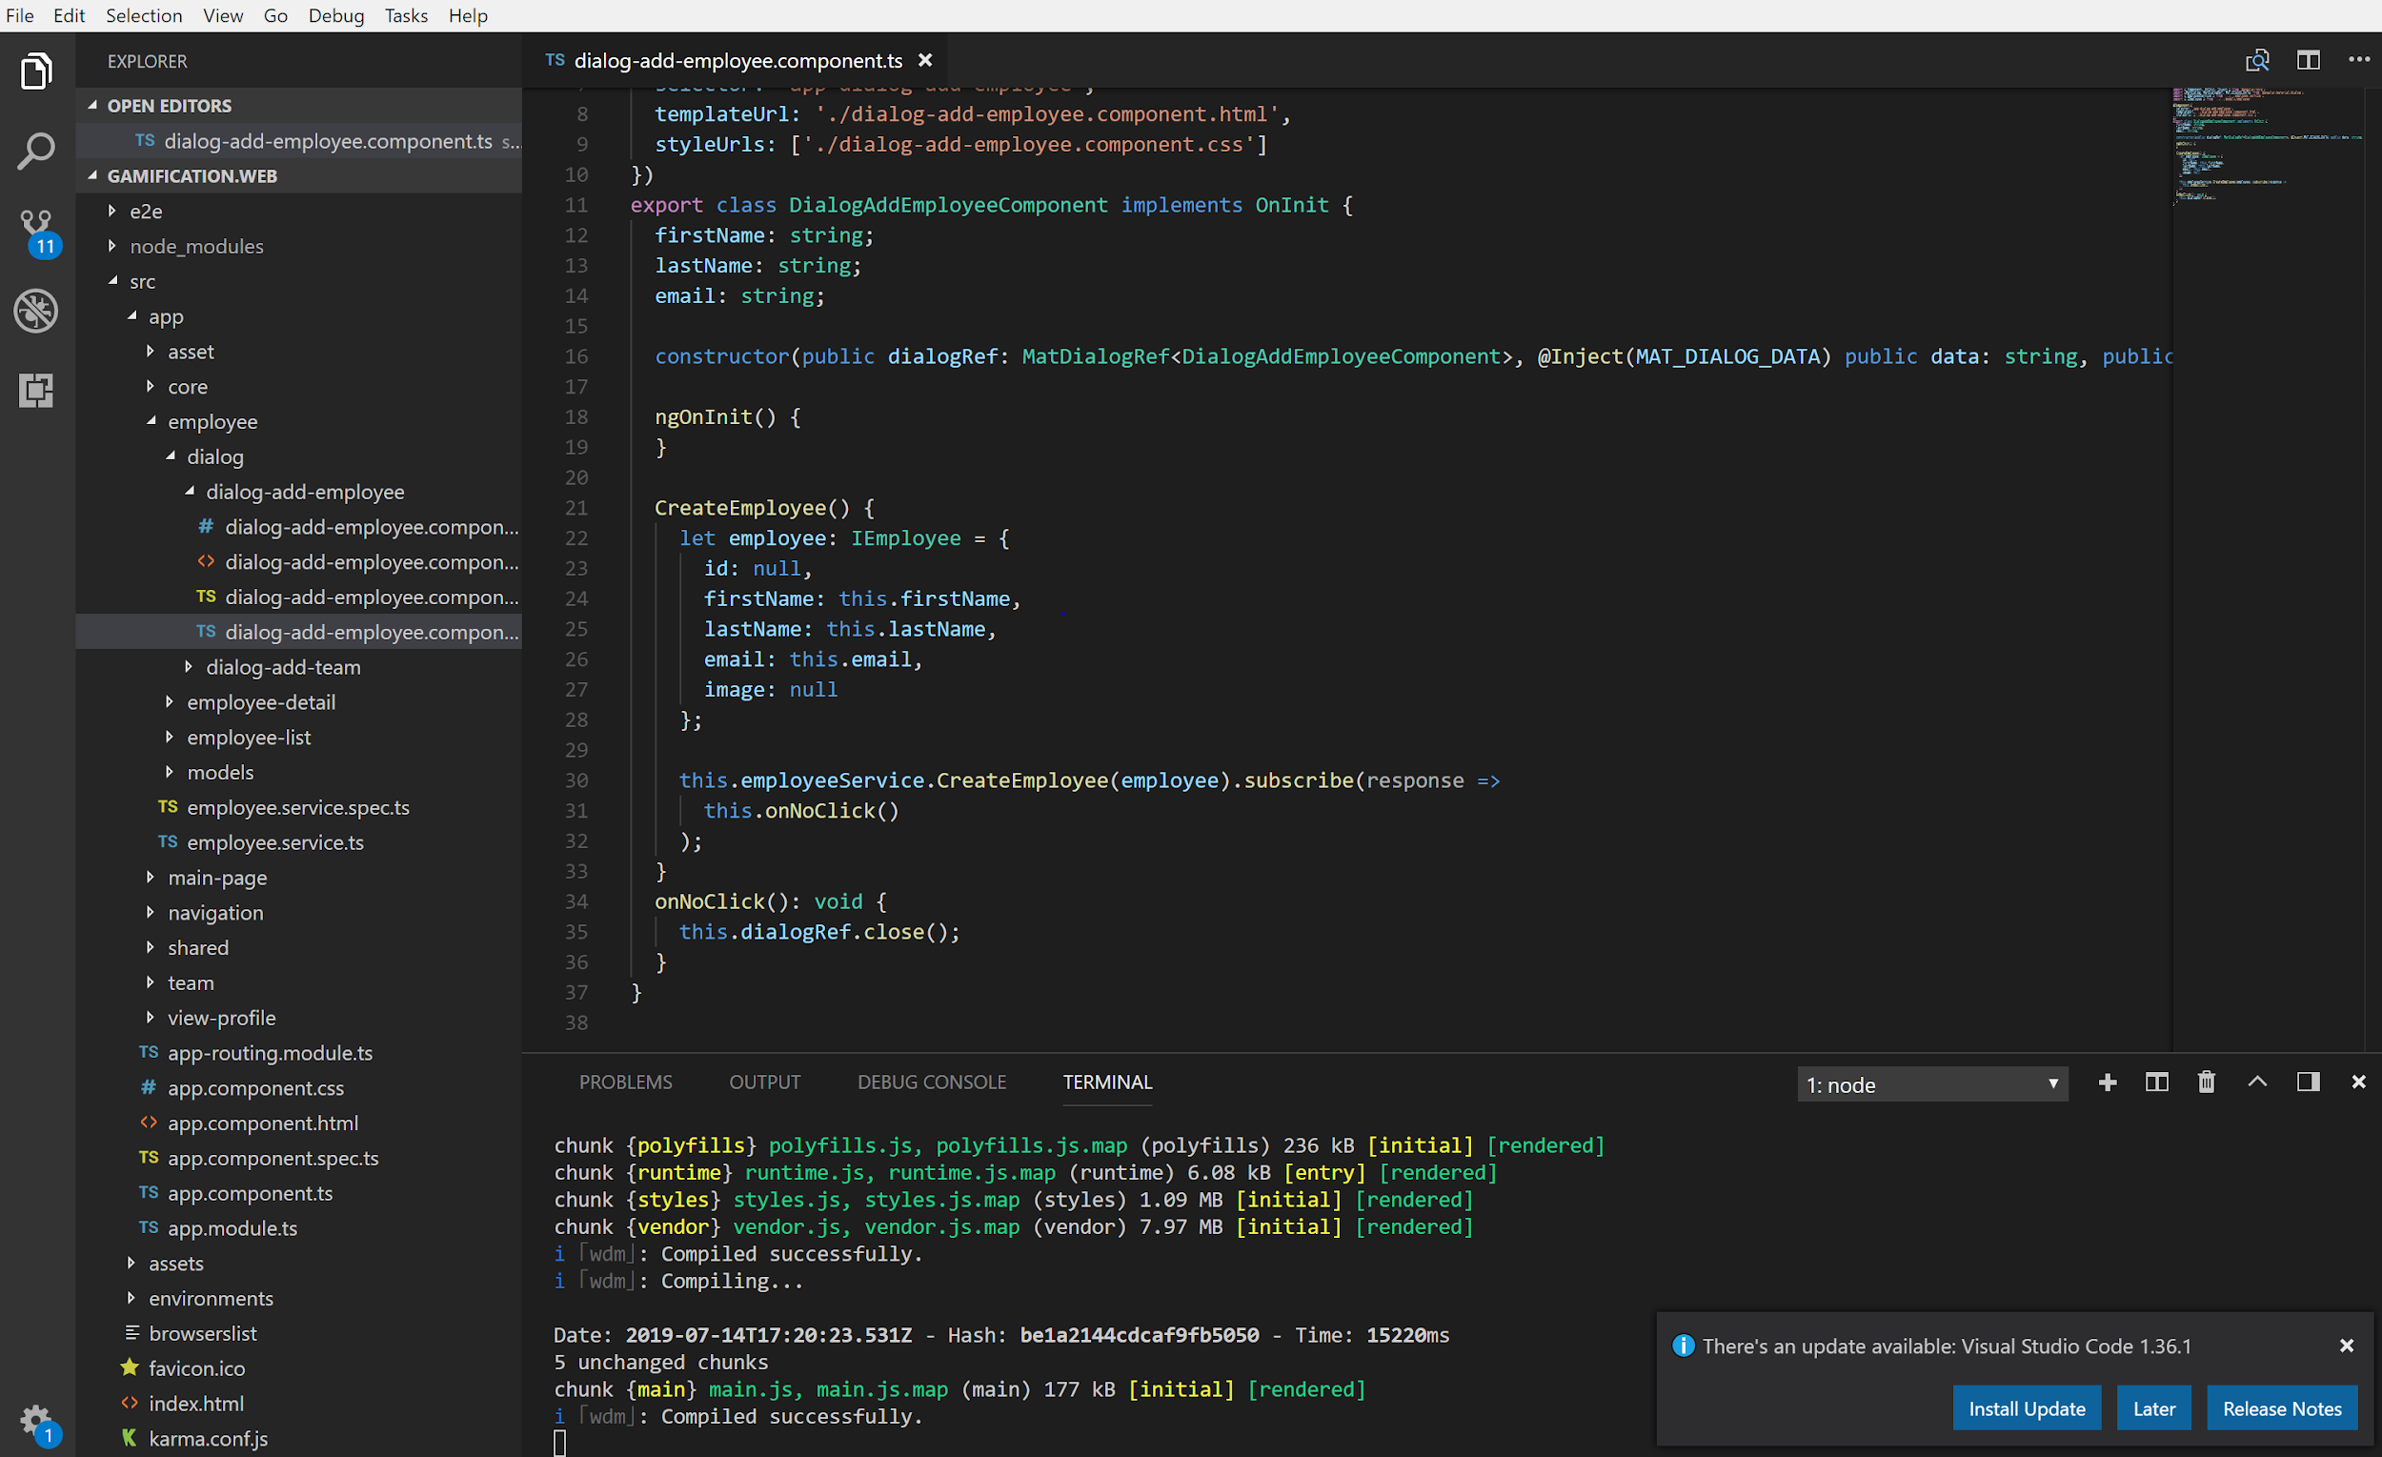
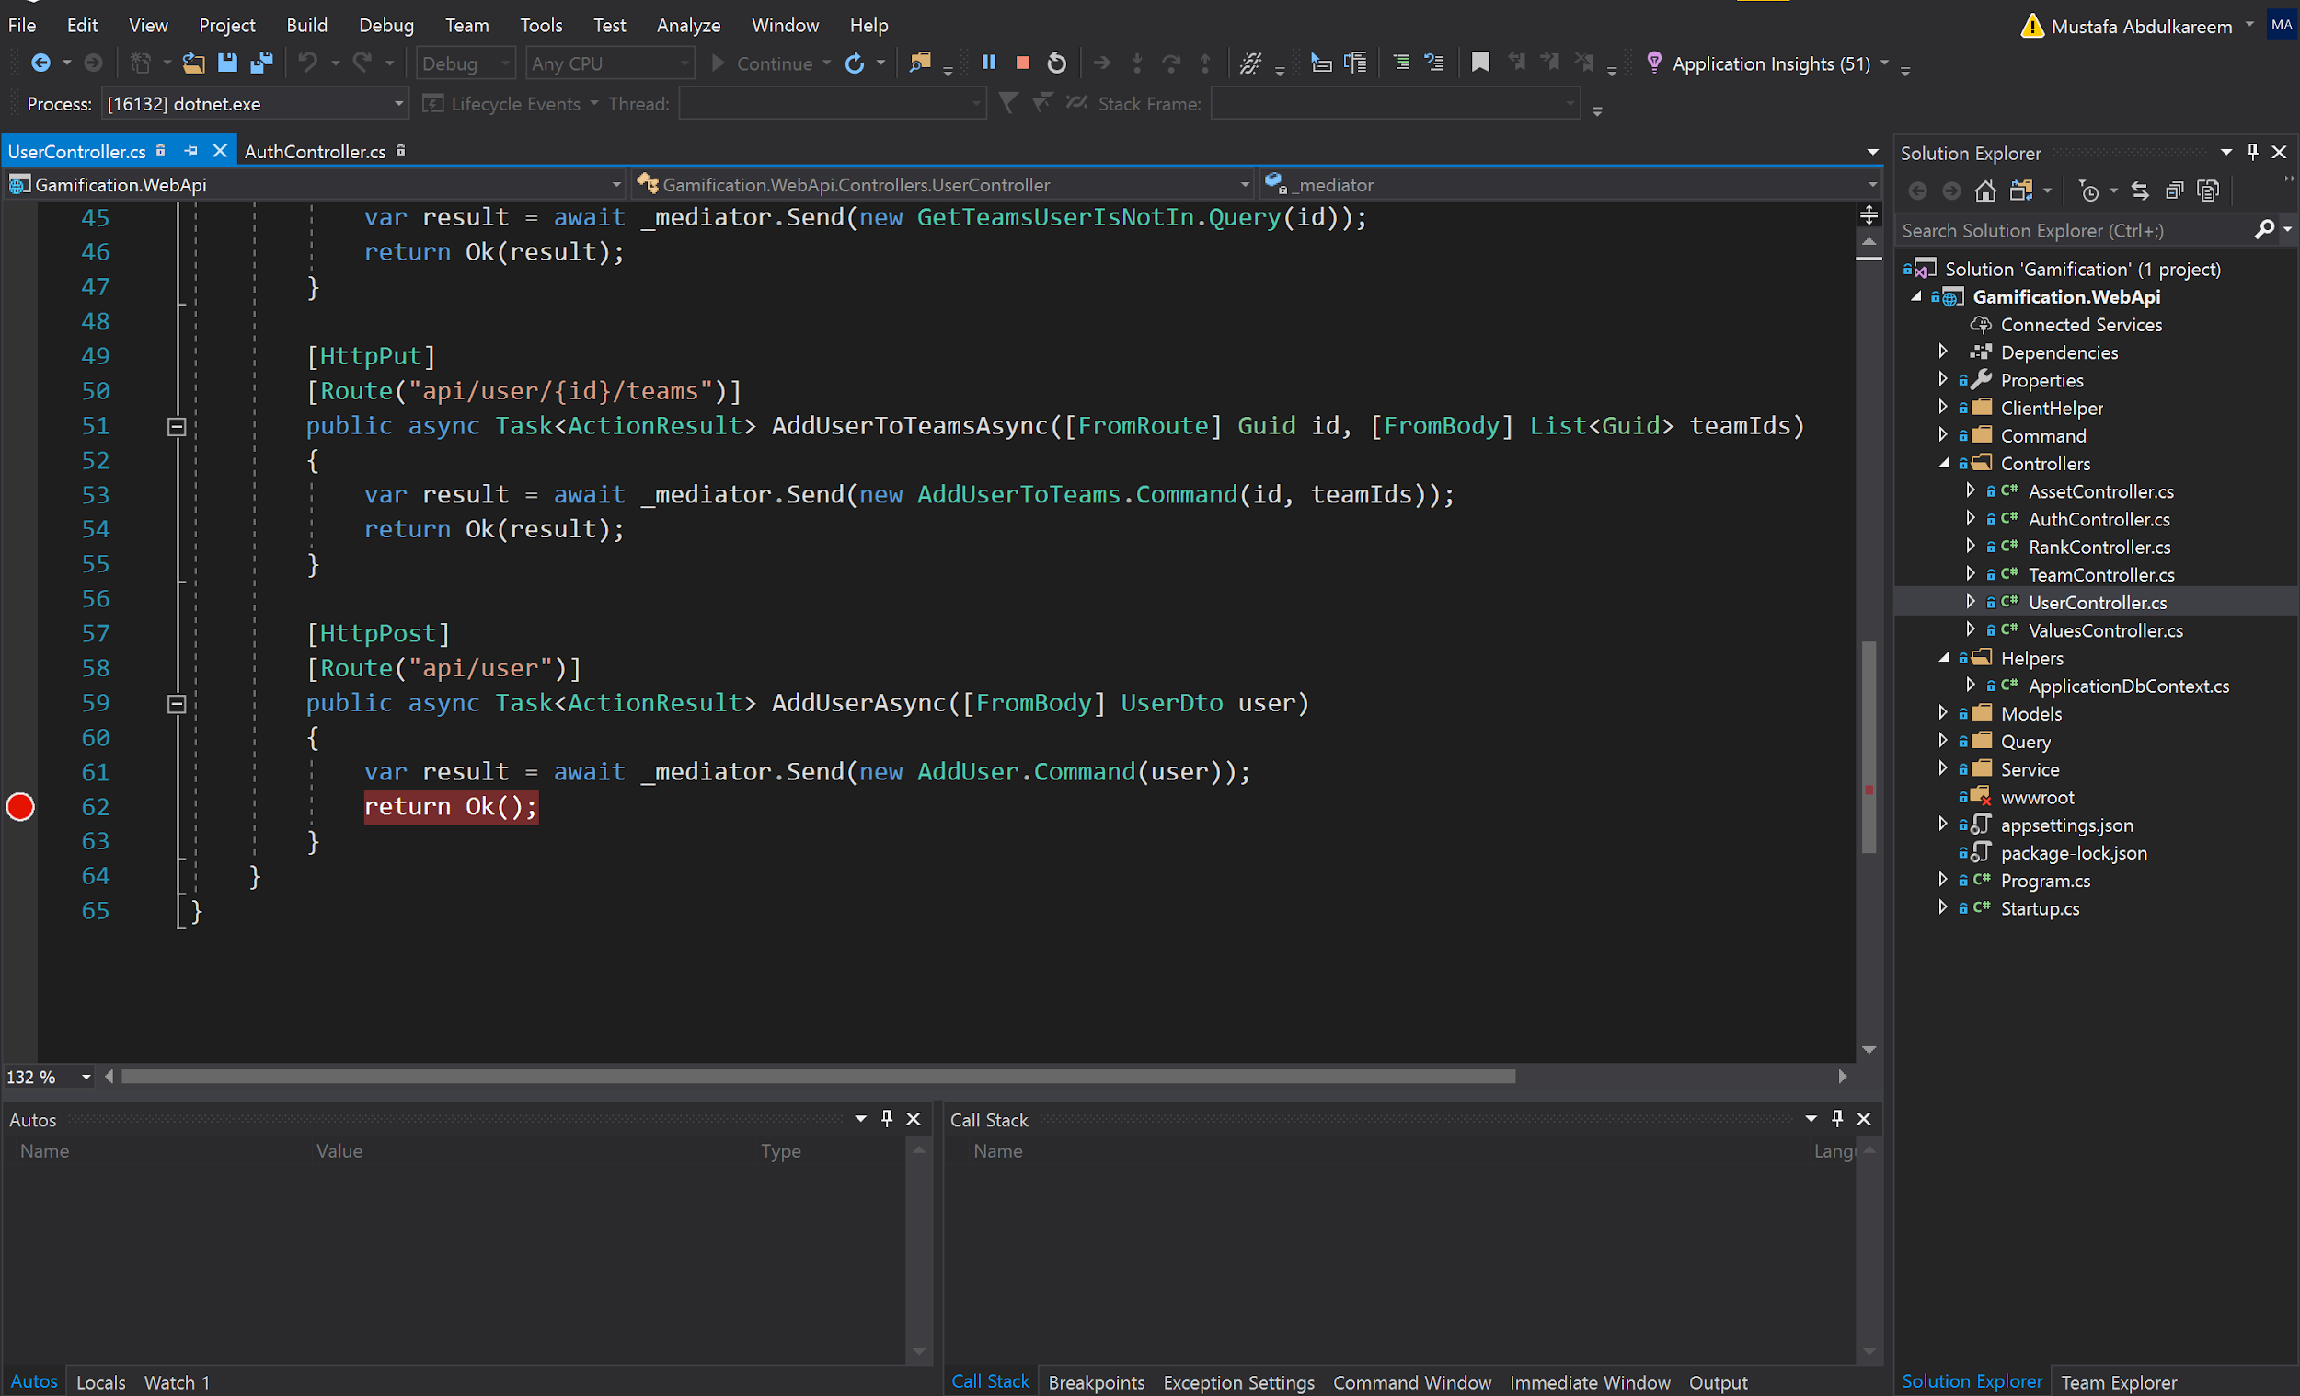
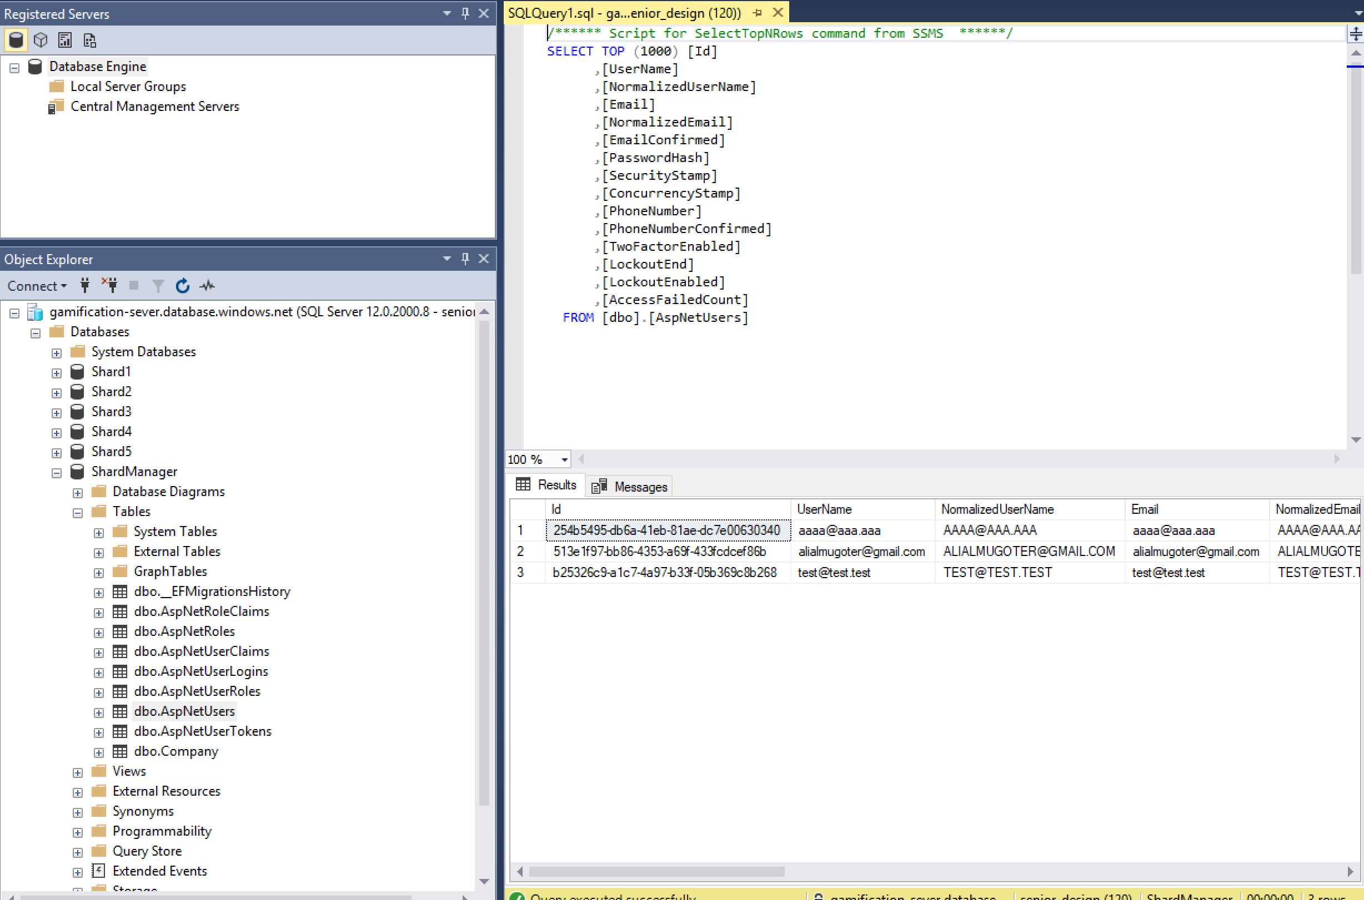

Slide 6
Integration Testing
Testing procedure for integration
For integration testing we will be testing each component before committing the remote branch to the master branch. When a functionality is complete and has been tested on the remote branch, it will be reviewed by two other team members. Once both members approve the code, it will be pushed to the master branch and tested to see if the functionality integrates properly with the software.
Stubs and drivers required
Each component will be tested with a test function (stubs) which will be used to test the component without having all the functions of the software available.
Test cases and their purpose
Every component has a set of test cases that will be tested before and after integration.

Slide 7
Validation Testing
For validation testing we will work with the client to ensure the software is up to the their requirements. We will go through every feature with them and have them test out the software the way they will use it.
Black box testing will be used for our validation testing, since the client does not have the ability to see what's happening in the backend. Data will be inputted and the output will be analyzed for accuracy.
We meet once every 2 weeks to showcase the progress to the client, this allows us to get immediate feedback and adjust the project.
Examples
Database sharding
Score & weighted Score
Using emails for account creation

Slide 8
Higher-Order testing
The high-order testing procedure is specified below. For high-order testing we will be using different test methods (Stress Testing, Performance Testing, and Security Testing) to test different conditions.
Security testing
For security testing we will be testing the two-level user authentication at login as well as SQL injection testing.
Stress testing
For stress testing we will be testing at varying frequencies with abnormal data inputs in large sums to validate the breaking point of the software.
Performance testing
For performance testing we will be testing the range of performance to know the softwares compatibility and functionality.
Notes:
-SQL Injection : Parameterized queries remove the possibility of "dirty" input changing the meaning of the query. That is, if the input contains SQL, it can't become part of what is executed because the SQL is never injected into the resulting statement.
One of the things that needs to be tested for performance is the server response time which depends on the host the client decides to use.
We will also be testing algorithm efficiency.
If we can make our algorithm more efficient, then the response time will be faster.

Slide 9
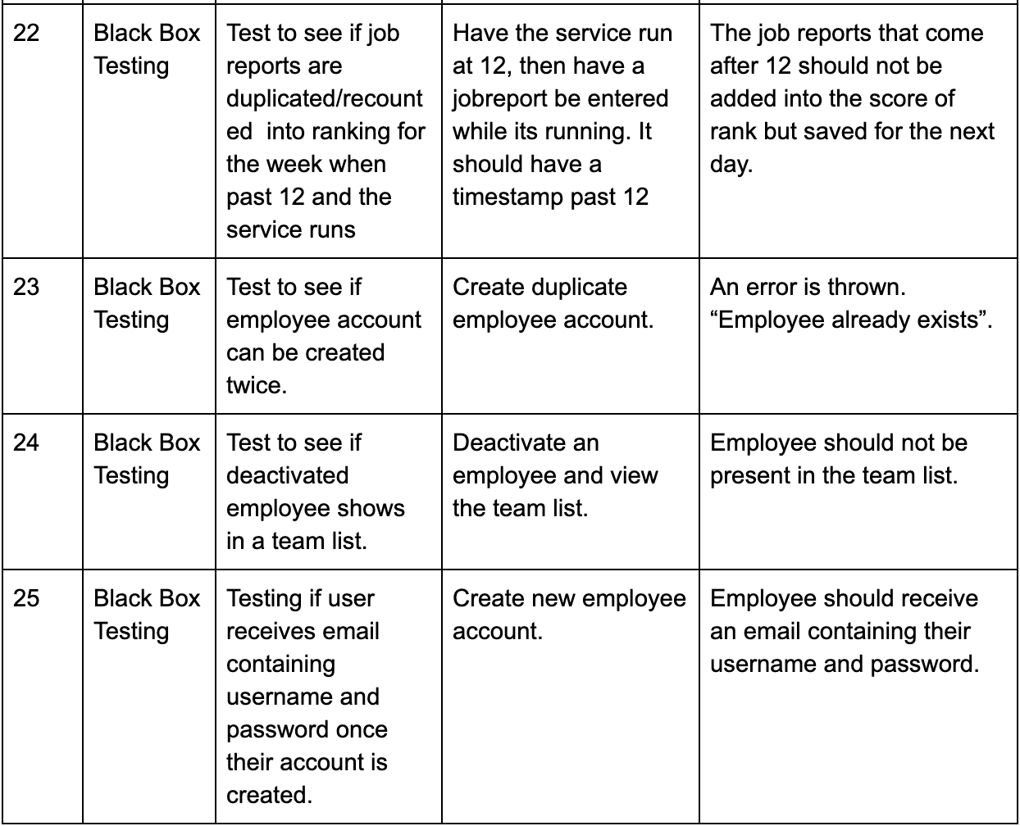
Test Cases

